Slide 1
CMP1103: INFORMATION & COMMUNICATION TECHNOLOGY
LECTURES: Monday 10am - 12pm
Tuesday : 10am – 12pm
Venue: CEDAT Conference Hall, M1
Lecturers: Mark Kagarura
Edward Seremba
Contact: serembae@gmail.com
Room 163, Old Building
© Bomugisha Denis

Slide 2
INTRODUCTION: DEFINITIONS
ICT: - According to the International Literacy Panel , “ICT literacy” is using digital technology, communications tools, and/or networks to access, manage, integrate, evaluate and create information in order to function in a knowledge society.”
ICT is therefore an umbrella term that includes any communication device or application, encompassing: radio, television, cellular phones, computer and network hardware and software, satellite systems and so on, as well as the various services and applications associated with them, such as videoconferencing and distance learning.

Slide 3
ICT DEFINITION CONT’D
A diverse set of technological tools and resources used to communicate, and to create, disseminate, store, and manage information. These technologies include computers, the Internet, broadcasting technologies (radio and television), and telephony.

Slide 4
INFORMATION TECHNOLOGY (IT)
As defined by the Information Technology Association of America (ITAA), "IT is the study, design, development, implementation, support or management of computer-based information systems, particularly software applications and computer hardware."
In general terms, it is any technology that deals with production, manipulation, storage, communication, and/or dissemination of information.
Information Technology involves the use of hardware, software, services, and supporting infrastructure to manage and deliver information using voice, data, and video.
It includes computers and communication systems.

Slide 5
The relationship between IT and ICT
IT comprises the knowledge, skills and understanding needed to employ information and communications technologies appropriately, securely and fruitfully in learning, employment and everyday life.
Any product that stores, retrieves, manipulates, transmits or receives information electronically in a digital form can be called an ICT product.

Slide 6
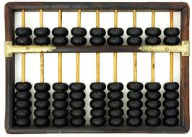
COMPUTER HISTORY
The First Calculators: The Abacus
Originated from Asia
For performing arithmetic processes.
500-1000 BC

Slide 7
The Mechanical Age: 1450 - 1840 The First General Purpose "computers“
The slide rule in the 1620
Invented by William Oughtred and Edmund Gunter
Based on the emerging work on logarithms by John Napier.
Used primarily for multiplication and division, and also for functions such as roots, logarithms and trigonometry, but is not normally used for addition or subtraction.

Slide 8
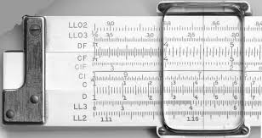
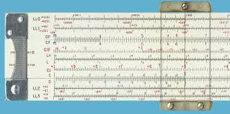
SLIDE RULE

Slide 9
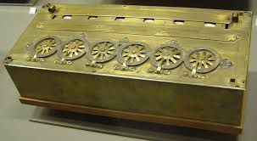
PASCAL’S CALCULATOR – THE PASCALINE
Invented by Blaise Pascal in 1642
Only add and subtract
also called the "numerical wheel calculator

Slide 10
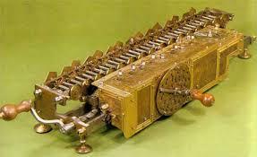
The Leibniz's Mechanical Multiplier
Gottfried Wilhelm von Leibniz, the German philosopher and law professor in 1673.
Multiplication by repeated addition and shifting

Slide 11
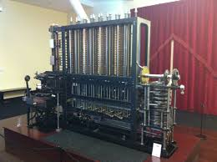
The difference engine
Proposed by Charles Babbage in 1822
Automatic mechanical calculator designed to tabulate polynomial functions

Slide 12
The Electronic Age: 1940 – Present
Four generations of computers have evolved.
Each generation of computer is characterized by a major technological development that fundamentally changed the way computers operate, resulting in increasingly smaller, cheaper, and more powerful, efficient and reliable devices.

Slide 13
The First Generation: 1946-1958
The Electronic Numerical Integrator and Computer (ENIAC)
Built by Presper Eckert and John Mauchly
Used vacuum tubes
Took up a lot of space and gave off a great deal of heat
Could perform 5,000 simple addition or subtraction operations
weighed more than 30 short tons (27 t), was roughly 8 by 3 by 100 feet (2.4 m × 0.9 m × 30 m), took up 1800 square feet (167 m²), and consumed 150 kW of power.

Slide 14
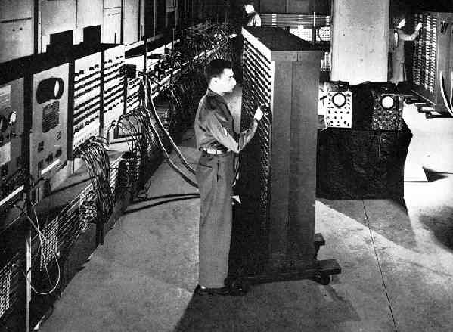

Slide 15
The Second Generation: 1959-1964
Used Transistors.
transistor was faster, more reliable, smaller, and much cheaper to build than a vacuum tube. One transistor replaced the equivalent of 40 vacuum tubes.
Generated Less heat
Smaller than First Generation computer
Moved from binary machine language to symbolic, or assembly languages, which allowed programmers to specify instructions in words.

Slide 16
SECOND GENERATION CONTD…
High – level Programming languages were also being developed at this time, such as early versions of COBOL and FORTRAN
First computers that stored their instructions in their memory, which moved from a magnetic drum to magnetic core technology.

Slide 17
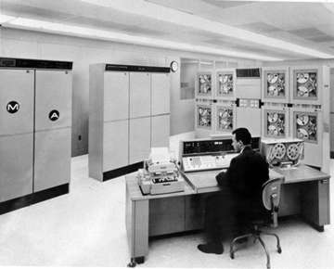
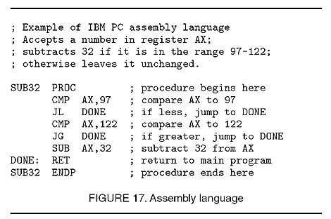
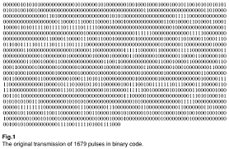

Slide 18
The Third Generation:
Used Integrated Circuits (Large Scale Integrated Circuits - LSI)
The integrated circuit, packs a huge number of transistors onto a single wafer of silicon.
Placing such large numbers of transistors on a single chip vastly increased the power of a single computer and lowered its cost considerably.
could carry out instructions in billionths of a second
size of these machines dropped to the size of small file cabinets.

Slide 19
THIRD GENERATION…
Instead of punched cards and printouts, users interacted with third generation computers through keyboards and monitors and interfaced with an operating system, which allowed the device to run many different applications at one time with a central program that monitored the memory.
First commercially available computers

Slide 20
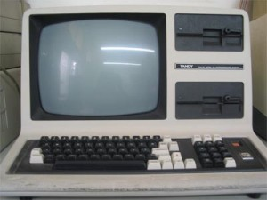

Slide 21
The Fourth Generation: 1971-Today
Used Microprocessors (Very Large Scale Integrated Circuits- VLSI)
A single chip that could do all the processing of a full-scale computer.
By putting millions of transistors onto one single chip more calculation and faster speeds could be reached by computers. This is due to the fact that electricity travels about a foot in a billionth of a second, the smaller the distance the greater the speed of computers.
1970's - people began buying computers for personal use.
Fourth generation computers also saw the development of Graphical User Interfaces, the mouse and hand-held devices

Slide 22
FIFTH GENERATION
Future generation of computers characterized by Artificial Intelligence (AI)
Computers will have cognitive abilities i.e. the ability to learn and adapt to changing situations.

Slide 23
A Computer : Definition
An electronic device that accepts input of data, processes it according to specific instructions, outputs the resulting information and may store it for future use.
Data:- The quantities, characters, or symbols on which operations are performed by a computer
Information: - Data that has been processed.

Slide 24
PARTS OF A COMPUTER
Software – Set of instructions that give/specify/determine the computer functionalities or operation
Hardware – Physical and tangible components that make up the computer system
Humanware – Human users of the computer system who interact with the software and hardware to achieve desired objectives on the computer

Slide 25
COMPUTER HARDWARE
Input Devices
Output Devices
Storage Devices

Slide 26
INPUT DEVICES
Any machine that feeds data into a computer.
Keyboard
Mouse
Touch Screen
Scanner
Camera
Microphone
Light pen

Slide 27
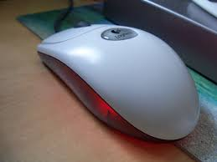
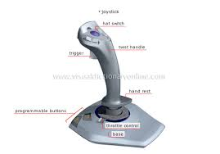
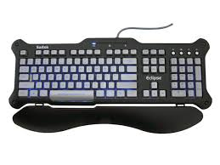

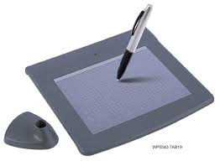
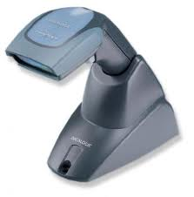
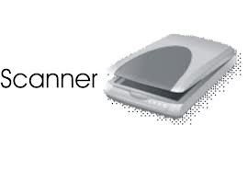
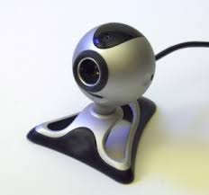

Slide 28
OUTPUT DEVICES
Monitors.
Projectors.
Printers.
Speakers.
Headphones.
Plotters.
DVD writers.
Fax machine.

Slide 29
STORAGE DEVICES
Hard disk
DVDs
CDs
Magnetic tape
Flash memory (USB memory sticks)
Cassette tapes

